Slide 1


Internship Project
By Faaiz

Slide 2
The Aim of this project
This project aim is to build and train a deep neural network model to detect fake or spam instagram accounts.
These days spam accounts have become a major problem in in all the social media platforms.
Many users are creating fake accounts to create an illusion of having many followers to thier personal accounts.
Fake accounts are being created to sell fake products and services.
They are also being used to impersonate other account users from common people to celebrities in order to influence, criticize, hurt feelings and reputation.

Slide 3
Data Description
PROFILE PICTURE - Wether the user has profile picture or not.
NUMS/LENGTH USERNAME - number of numerical chars in username to its length.
FULLNAME WORDS - Full name in word tokens
NAME/LENGTH OF FULL NAME - The ratio of number of numerical characters in full name to its length.
NAME == USERNAME - Are username and full name literally the same?
DESCRIPTION LENGTH - Bio length in characters.
EXTERNAL URL - Has external URL or not.
PRIVATE - Private or not.
POSTS - Number of posts.
FOLLOWERS - Number of followers.
FOLLOWS - Number of follows.

Slide 4
How the model works
This model is trained such that it considers the above given features and determines whether a particular account is fake or not. By resulting the output as either 0 or 1 meaning TRUSTED or FAKE respectively. Our intention is to make this software capable of thinking like a human, based on the data it is given and results in maximum probability of success.

Slide 5
Methodology
Loading libraries
Loading Datsets
Performing exploratory Data Analysis (A form of data selection)
Data Preparation: To feed the Model
Building and Training the deep learning model
Evaluating the performance of the model to initialize a project report

Slide 6
Training Process
ANN training
To train my model i am using a neural network called ANN or called Artificial Neural network it, basically it is a simple neural network,The neuron collects information from input channels named dendrites, processes information in its nucleus and then generates an output in a long thin branch called Axon.some of its activation funcions include:
1. Sigmoid
-Takes a number between 0 and 1
-Converts large negative numbers to zero and converts large positive numbers to 1
-It is generally used as Output Layer. but in our model, we are using softmax as the ouput layer.
2. Softmax
-The softmax function is sometimes called the softargmax function, or multi-class logistic regression. This is because the softmax is a generalization of logistic regression that can be used for multi-class classification, and its formula is very similar to the sigmoid function which is used for logistic regression.

Slide 7

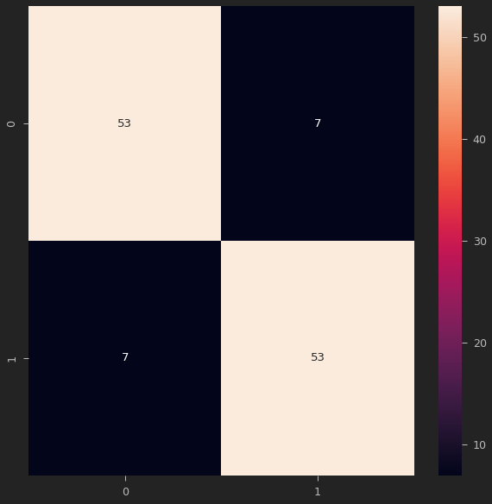
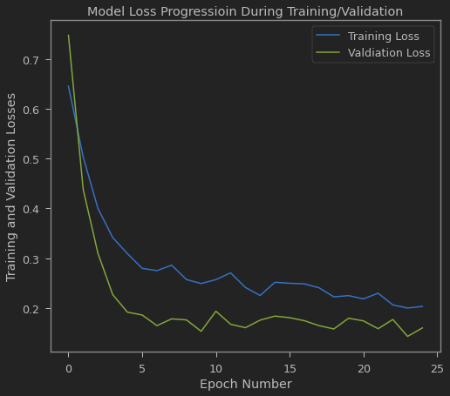
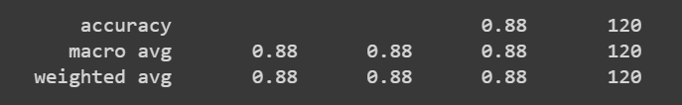

Project Report
We achieved 97% percent accuracy in detecting the fake accounts by training the model using datasets and 88% percent accuracy in testing . We have checked whether the model has reached the ability to detect an account is fake or not by inputting different set of data values.
We could say our model is pretty accurate and has a good
I then proceeded to test it by inputing values that were not their in the training and testing dataset:
At which it got a 88% accuracy score :
The model is hence trained to detect fake accounts in instagram based on the considered features.

